Slide 1
The Science of Static Electricity

Slide 2
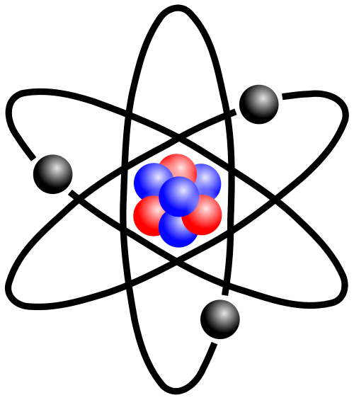
All Matter is Made of Atoms
Atoms consist of a nucleus made of particles called protons and neutrons, orbited by electrons

Slide 3
Atoms are Electrically Neutral
Atoms have the same number of protons (+) and electrons (-) and have no charge
Neutrons have no charge
It is easier to remove an electron from an atom than to remove a proton
Removing an electron creates a charged atom (an “ion” having an uneven number of protons and electrons)
A positive charge indicates more protons than electrons; a negative charge indicates more electrons than protons

Slide 4
Opposite Charges Attract

Slide 5
Like Charges Repel

Slide 6
Your experience with charged particles…
What happens when you rub a balloon on your hair?
What happens if you try to stick that same balloon (after rubbing it across your hair) to the wall?
WHY?

Slide 7
What is Static Electricity?
Static means staying in place; it is an electric charge that is not moving
Electrical current consists of electrons flowing over a wire or some other conducting pathway
With static electricity, there is no path for the electrons to move along, so the charge builds up until there is enough energy for the electrons to jump to something with a positive charge

Slide 8
If you shuffle your feet across a carpet, you pick up electrons from the rug. Now you have extra electrons. If you touch a metal doorknob next, your extra electrons move from you to the knob and you feel a shock.

Slide 9
Materials have been ranked according to their ability to hold or give up electrons

Slide 10
When 2 of the materials on this list are rubbed together, the one higher on the list will give up electrons and become positively charged.
Your hand
Glass
Nylon
Wool
Fur
Silk
Paper
Cotton
Hard rubber
Polyester
PVC plastic

Slide 11
What’s the Most Powerful Natural Static Discharge on Earth?

Slide 12
Static Safety
What problems might static cause in the industrial workplace?
Static discharge can throw a spark and start a fire. It can overload circuits and melt electronic components.

Slide 13
Static Safety
What are the conditions or measures for preventing static discharge?
Various means of grounding are used.
On machinery, a metal conductor leading to the ground
On workers, footwear that conducts static away
Conductive shoes must be removed when the task requiring their use is completed. Employees exposed to electrical hazards must never wear conductive shoes.

Slide 14
For More Information
A Health and Safety Guide for Your Workplace: Static Electricity from the Industrial Accident Prevention Association http://www.iapa.ca/pdf/2004_feb_Static%20Electricity.pdf

